Slide 1

Attrition in the Workplace
Case Study 02

Slide 2

Richard Kim
richardk@smu.edu
Data Analyst
SJ Design Studio
The Center Counseling
Data Science Master’s Student at Southern Methodist University

Slide 3



Today’s Presentation
Data Cleaning Process
Income Model
Attrition Model

Slide 4



Data Cleaning Process

Slide 5

Missing Values
Income missing in the attrition dataset
Attrition missing in the income dataset
Can’t use income to predict attrition
Delete Monthly Income
Impute Monthly Income

Slide 6

Income Model

Slide 7

Predict Monthly Income
Total Working Years
Job Level
Job Role

Slide 8

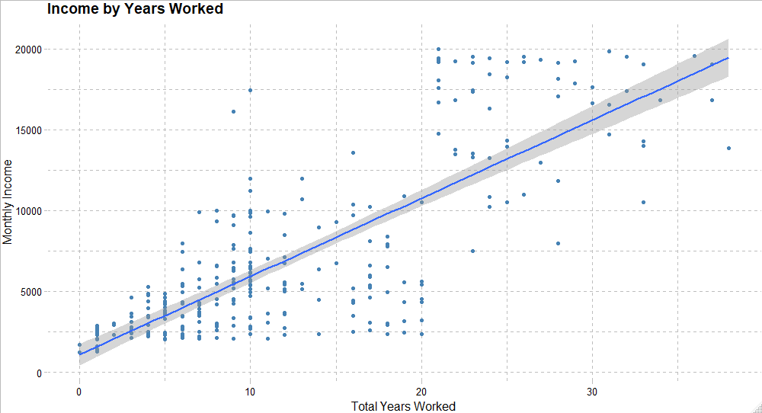
Total Working Years

Slide 9


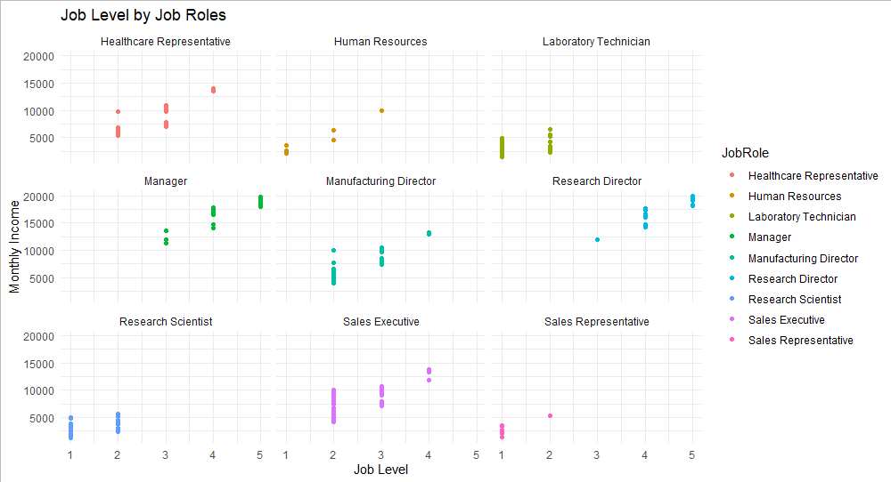
Job Level by Job Roles

Slide 10
Predict Monthly Income
Adjusted R²
95%
RMSE
Relatively Low

Slide 11

Attrition Model

Slide 12

Predictors of Attrition
Monthly Income
Age
Overtime Status
Job Role
Education Field
Marital Status
Frequency of Business Travel
Job Satisfaction
Years Since Last Promotion
Years with Current Manager
Years in Current Role
14.24%

Slide 13

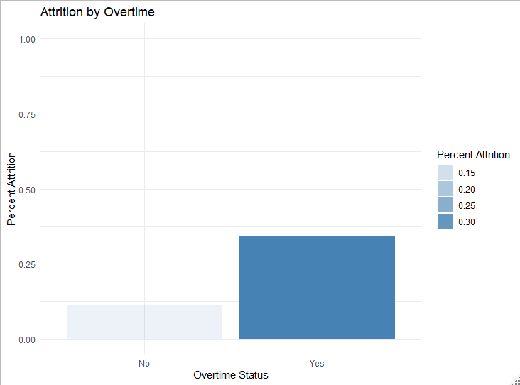
Overtime Status

Slide 14
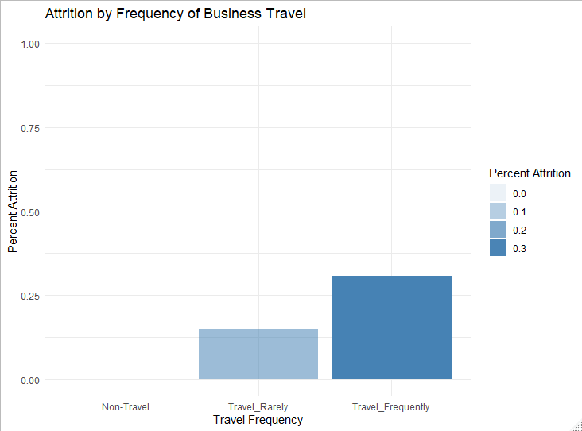
Business Travel Frequency

Slide 15
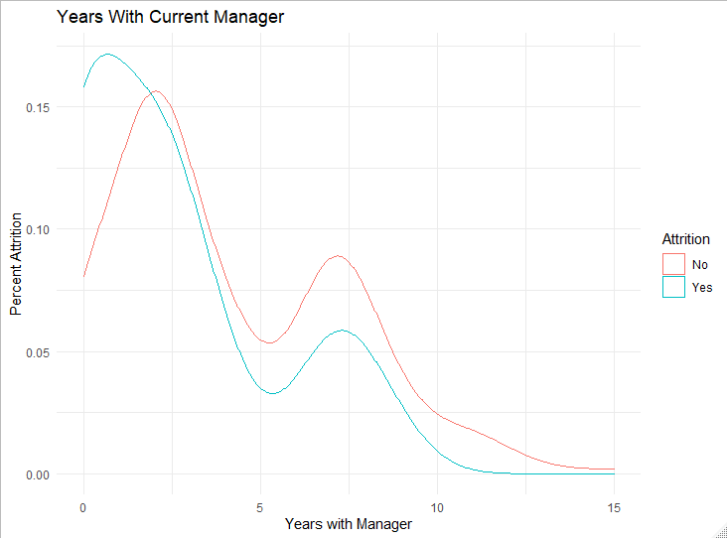
Years Worked with Manager

Slide 16
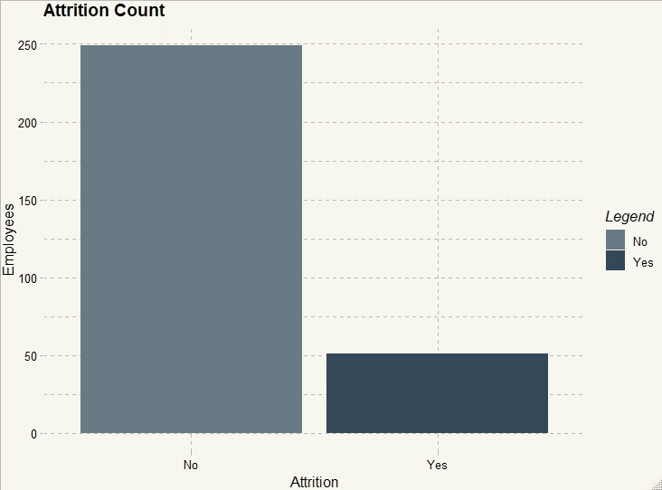
Attrition
No: 83.33%
Yes: 16.67%

Slide 17
Evaluating the Model
Accuracy 66.39%
Sensitivity 65.05%
Specificity 72.95%
No Information Rate 83.33%
Why is this model good?

Slide 18
Next Steps
Test more combinations of variables
Explore other models
Gather more variables

Slide 19

Thank You
Richard Kim
richardk@smu.edu

Slide 20
Imputation Plan
Income Prediction Model
 |  |  |  | Income | Attrition
 |  |  |  | Income | Attrition
 |  |  |  | ???
 |  |  |  | ???
 |  |  |  | ???
 |  |  |  | ???
 |  |  |  | ???
 |  |  |  | ???
 |  |  |  | ???
 |  |  |  | Income | Attrition
 |  |  |  |  | ???
 |  |  |  |  | ???
 |  |  |  |  | ???
 |  |  |  |  | ???
 |  |  |  |  | ???
 |  |  |  |  | ???
 |  |  |  |  | ???

Slide 21
Imputation Plan
Attrition Prediction Model
 |  |  |  | Income | Attrition
 |  |  |  | Income | Attrition
 |  |  |  | Income | Attrition
 |  |  |  |  | ???
 |  |  |  |  | ???
 |  |  |  |  | ???
 |  |  |  |  | ???
 |  |  |  |  | ???
 |  |  |  |  | ???
 |  |  |  |  | ???

Slide 22

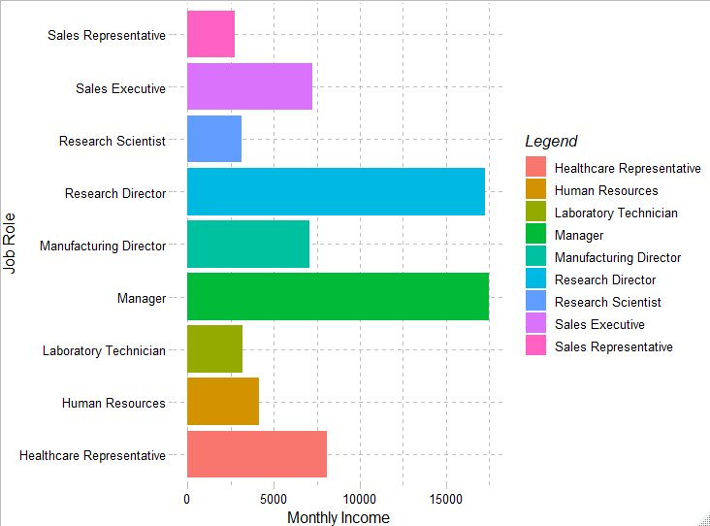
Monthly Income by Job Role

Slide 23
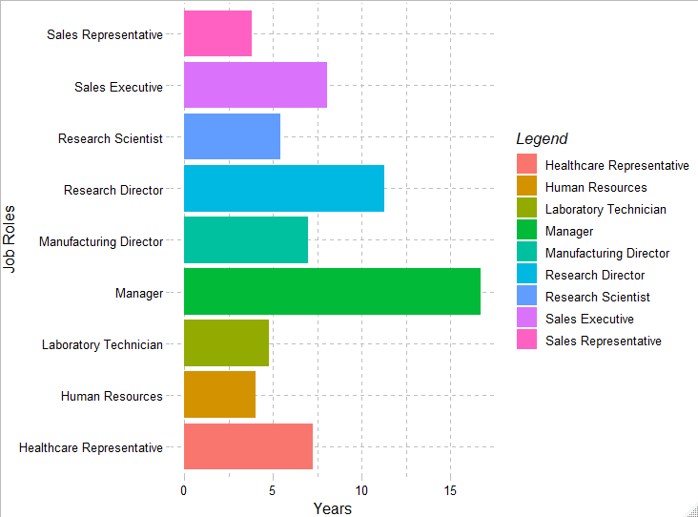
Years at the Company by Job Role

